Slide 1

Database Management Systems Cornerstone Project
Final Review (Review I & II)
LIBRARY MANAGEMENT SYSTEM
PRESENTED BY
B. Vyas Sri Nandan (25B11AI130)
Ch. Karthikeyan (25B11AI216)
M. Ravi Teja (25B11AI755)
K A V Manikanta (25B11AI589)
Department of Artificial Intelligence & Machine Learning

Slide 2

OVERVIEW
Presentation Outline
1
Abstract
9
Database Creation & Constraints
2
Introduction & Problem Statement
10
Sample Data Insertion
3
Objectives
11
DDL, DML & DQL Operations
4
Entities & Attributes
12
CRUD Operations & SQL Queries
5
ER Diagram
13
Data Integrity & Validation
6
Relational Database Schema
14
Project Documentation
7
Primary & Foreign Keys
15
Demonstration & Conclusion
8
GitHub Repository & Team
2

Slide 3
DESIGN
Project Title, Objectives & Problem Statement
Project Title: LIBRARY MANAGEMENT SYSTEM
A centralized DBMS to automate book tracking, member registration, and issue/return transactions.
PROBLEM STATEMENT
OBJECTIVES
Traditional libraries rely on manual ledgers or decentralized spreadsheets to track books, members, and transactions.
Time-consuming search for book availability & overdue tracking
Data redundancy & inconsistency across records
No analytics — fines, popular titles, usage reports
Automate core operations — issuing, returns, inventory tracking
Ensure data integrity with Primary & Foreign Key constraints
Enable fast search & retrieval via optimized SQL queries
Automate fine calculation based on due/return dates
Provide secure, role-based access for members & librarians
3

Slide 4
DESIGN
Entities & Attributes
BOOK
AUTHOR
Book_ID (PK), Title, Genre, Publication_Year, Total_Copies, Available_Copies, Publisher_ID (FK)
Author_ID (PK), First_Name, Last_Name, Nationality
PUBLISHER
MEMBER
Publisher_ID (PK), Publisher_Name, Contact_Number, City
Member_ID (PK), Full_Name, Email_Address, Membership_Date, Max_Books_Allowed
STAFF (LIBRARIAN)
TRANSACTION
Staff_ID (PK), Name, Role, Shift_Timing
Transaction_ID (PK), Book_ID (FK), Member_ID (FK), Issue_Date, Due_Date, Staff_ID (FK), Return_Date, Fine_Amount
4

Slide 5
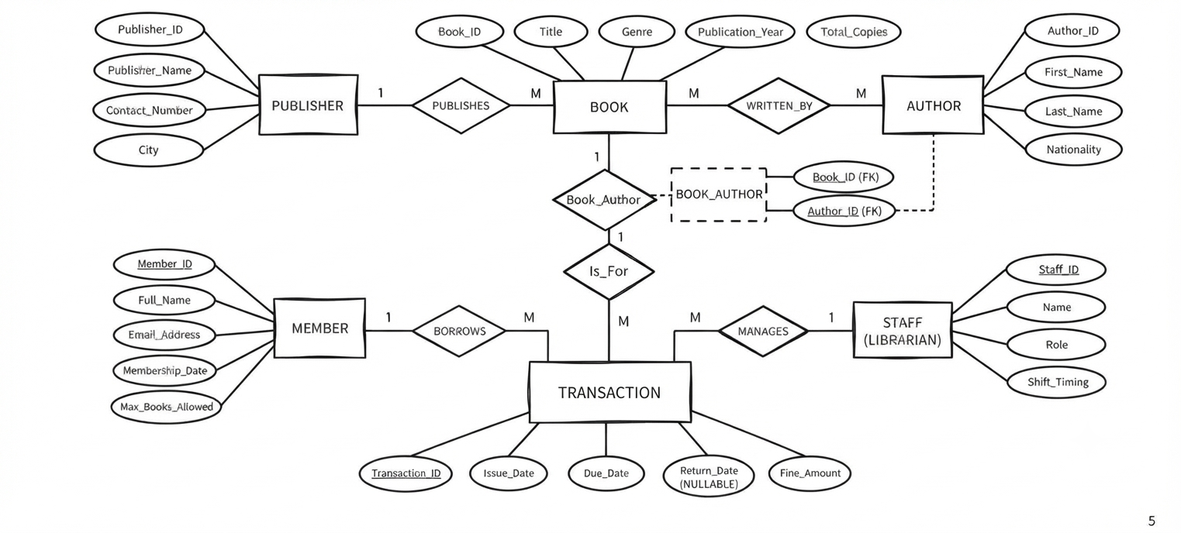
DESIGN
ER – Diagram Library management system
5

Slide 6
DESIGN
Relational Database Schema
PUBLISHER
AUTHOR
BOOK
BOOK_AUTHOR
MEMBER
TRANSACTION
Publisher_ID PK
Author_ID PK
Book_ID PK
Book_ID PK, FK
Member_ID PK
Transaction_ID PK
Publisher_Name
First_Name
Title
Author_ID PK, FK
Full_Name
Book_ID FK
Contact_Number
Last_Name
Genre
Email_Address
Member_ID FK
City
Nationality
Publication_Year
Staff
Membership_Date
Issue_Date
Total_Copies
Staff_ID
Name
Role
Shift_Timing
Max_Books_Allowed
Due_Date
Publisher_ID FK
Return_Date
Fine_Amount
BOOK_AUTHOR is a junction table resolving the many-to-many relationship between BOOK and AUTHOR. TRANSACTION bridges MEMBER and BOOK, converting their conceptual M:N borrowing relationship into two 1:M relationships.
6

Slide 7
DESIGN
Primary & Foreign Keys
Table | Primary Key | Foreign Key(s)
MEMBER | Member_ID | None
PUBLISHER | Publisher_ID | None
AUTHOR | Author_ID | None
STAFF | Staff_ID | None
BOOK | Book_ID | Publisher_ID → PUBLISHER
BOOK_AUTHOR | (Book_ID, Author_ID) | Book_ID → BOOK, Author_ID → AUTHOR
TRANSACTION | Transaction_ID | Book_ID → BOOK, Member_ID → MEMBER
7

Slide 8
DESIGN
GitHub Repository & Team Responsibilities
Repository:
BV
CK
MR
KA
B. Vyas Sri Nandan
Ch. Karthikeyan
M. Ravi Teja
K A V Manikanta
25B11AI130
25B11AI216
25B11AI755
25B11AI589
Database Design & ER Modeling
SQL Implementation
Data & Query Development
Testing & Documentation
Entities, attributes, ER diagram, relational schema
DDL scripts, constraints, table creation
Sample data, DML/DQL, CRUD & joins
Validation, integrity checks, final report
8

Slide 9
IMPLEMENTATION
Database Creation & Constraints
CREATE DATABASE library_db;
CREATE TABLE PUBLISHER (
Publisher_ID INT PRIMARY KEY,
Publisher_Name VARCHAR(100) NOT NULL,
Contact_Number VARCHAR(15) UNIQUE,
City VARCHAR(50) DEFAULT 'Unknown'
);
CREATE TABLE BOOK (
Book_ID INT PRIMARY KEY,
Title VARCHAR(150) NOT NULL,
Genre VARCHAR(50),
Publication_Year INT CHECK (Publication_Year > 1500),
Total_Copies INT DEFAULT 1 CHECK (Total_Copies >= 0),
Publisher_ID INT,
FOREIGN KEY (Publisher_ID) REFERENCES PUBLISHER(Publisher_ID)
);
CREATE TABLE TRANSACTION (
Transaction_ID INT PRIMARY KEY,
Book_ID INT NOT NULL,
Member_ID INT NOT NULL,
Issue_Date DATE NOT NULL,
Due_Date DATE NOT NULL,
Return_Date DATE,
Fine_Amount DECIMAL(6,2) DEFAULT 0.00,
FOREIGN KEY (Book_ID) REFERENCES BOOK(Book_ID),
FOREIGN KEY (Member_ID) REFERENCES MEMBER(Member_ID)
);
CONSTRAINTS APPLIED
PRIMARY KEY
Uniquely identifies each row (Book_ID, Member_ID, Transaction_ID, ...)
FOREIGN KEY
Enforces referential integrity between related tables
NOT NULL
Prevents missing values in mandatory fields (Title, Name, Issue_Date)
UNIQUE
Prevents duplicate publisher contact numbers / member emails
CHECK
Validates Publication_Year and non-negative copy counts
DEFAULT
Auto-fills Total_Copies = 1 and Fine_Amount = 0.00
9

Slide 10
IMPLEMENTATION
Sample Data Insertion
INSERT INTO PUBLISHER VALUES
(1, 'Penguin House', '9876543210', 'Delhi'),
(2, 'Oxford Press', '9123456780', 'Mumbai');
INSERT INTO AUTHOR VALUES
(1, 'R.K.', 'Narayan', 'Indian'),
(2, 'J.K.', 'Rowling', 'British');
INSERT INTO BOOK VALUES
(101, 'Malgudi Days', 'Fiction', 1943, 4, 1),
(102, "Harry Potter", 'Fantasy', 1997, 6, 2);
INSERT INTO MEMBER VALUES
(201, 'Aditi Sharma', 'aditi@mail.com',
'2024-06-01', 3),
(202, 'Rahul Verma', 'rahul@mail.com',
'2024-07-15', 3);
INSERT INTO TRANSACTION
(Transaction_ID, Book_ID, Member_ID,
Issue_Date, Due_Date)
VALUES
(301, 101, 201, '2025-01-05', '2025-01-19');
MEMBER (sample rows)
Member_ID | Full_Name | Email | Max_Books
201 | Aditi Sharma | aditi@mail.com | 3
202 | Rahul Verma | rahul@mail.com | 3
TRANSACTION (sample rows)
Txn_ID | Book | Member | Issue | Due
301 | 101 | 201 | 05-Jan | 19-Jan
Sample data was inserted for all 6 tables — enough rows per table to demonstrate joins, aggregate functions, and fine-calculation logic end-to-end.
10

Slide 11
IMPLEMENTATION
DDL, DML & DQL Operations
DDL
DML
DQL
Data Definition Language
Data Manipulation Language
Data Query Language
ALTER TABLE BOOK
ADD COLUMN Language
VARCHAR(30);
DROP TABLE IF EXISTS
temp_backup;
UPDATE TRANSACTION
SET Return_Date='2025-01-18'
WHERE Transaction_ID=301;
DELETE FROM MEMBER
WHERE Member_ID=999;
SELECT Title, Genre
FROM BOOK
WHERE Total_Copies > 3
ORDER BY Publication_Year;
11

Slide 12
IMPLEMENTATION
CRUD Operations & SQL Queries
-- JOIN: books with author & publisher
SELECT B.Title, A.First_Name, P.Publisher_Name
FROM BOOK B
JOIN BOOK_AUTHOR BA ON B.Book_ID = BA.Book_ID
JOIN AUTHOR A ON BA.Author_ID = A.Author_ID
JOIN PUBLISHER P ON B.Publisher_ID = P.Publisher_ID;
-- AGGREGATE: total fines per member
SELECT M.Full_Name, SUM(T.Fine_Amount) AS Total_Fine
FROM TRANSACTION T
JOIN MEMBER M ON T.Member_ID = M.Member_ID
GROUP BY M.Full_Name
HAVING SUM(T.Fine_Amount) > 0;
-- VIEW: currently issued (not yet returned) books
CREATE VIEW Currently_Issued AS
SELECT T.Transaction_ID, B.Title, M.Full_Name, T.Due_Date
FROM TRANSACTION T
JOIN BOOK B ON T.Book_ID = B.Book_ID
JOIN MEMBER M ON T.Member_ID = M.Member_ID
WHERE T.Return_Date IS NULL;
CRUD MAPPING
CREATE
INSERT INTO ... (new book, member, transaction)
READ
SELECT ... (search catalog, check availability)
UPDATE
UPDATE ... (mark return, apply fine)
DELETE
DELETE FROM ... (remove withdrawn member)
12

Slide 13
IMPLEMENTATION
Data Integrity & Validation
✓
No Duplicate IDs
✓
Valid References
✓
Domain Validation
PRIMARY KEY constraints on every table block duplicate Book_ID, Member_ID, Transaction_ID, etc.
FOREIGN KEY constraints ensure a transaction can never point to a non-existent Book or Member.
CHECK constraints reject invalid Publication_Year values and negative copy counts.
✓
Mandatory Fields
✓
Unique Contacts
✓
Consistent Defaults
NOT NULL constraints guarantee every book has a title and every transaction has an issue date.
UNIQUE constraints prevent two publishers or members from sharing the same contact/email.
DEFAULT values (Total_Copies=1, Fine_Amount=0.00) keep new records well-formed automatically.
13

Slide 14
IMPLEMENTATION
Project Documentation
📄
Problem statement, objectives & scope
📄
ER diagram with entities, attributes & relationships
📄
Relational schema with PK / FK mapping
📄
Full DDL scripts (tables + constraints)
📄
Sample data & DML/DQL query scripts
📄
CRUD operations, joins, views & aggregate queries
📄
Screenshots of query outputs & test results
📄
GitHub repository with version history
14

Slide 15
IMPLEMENTATION
Demonstration of the Working Database
1
→
2
→
3
→
4
→
5
Schema Setup
Load Data
Issue a Book
Return & Fine
Run Reports
Run DDL scripts to create the library_db database and all six tables with constraints.
Populate tables with sample publishers, authors, books, members, and transactions.
Insert a TRANSACTION row and show Total_Copies / availability update live.
Update Return_Date; run the fine-calculation query for overdue returns.
Execute joins, GROUP BY, and the Currently_Issued view to show live reports.
15

Slide 16
CONCLUSION
From Design to a Working Library Database
Designed a normalized 6-entity relational schema (Publisher, Author, Book, Book_Author, Member, Transaction) grounded in a clear ER model.
Implemented the schema in SQL with Primary/Foreign Key, NOT NULL, UNIQUE, CHECK, and DEFAULT constraints to guarantee data integrity.
Built working DDL, DML, and DQL scripts, plus CRUD operations, joins, aggregate queries, and a view for daily library operations.
Validated the system against duplicate-ID and referential-integrity risks, converting a manual, error-prone ledger into a reliable digital platform.
FUTURE ENHANCEMENTS
Web/mobile front-end integration • Automated overdue-reminder notifications • Role-based login for members & librarians • Analytics dashboard for usage trends
16

Slide 17
THANK YOU

